Slide 1
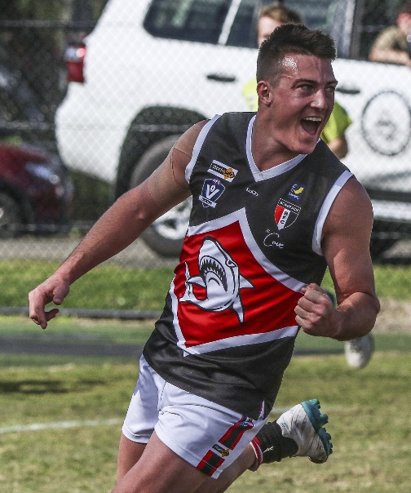
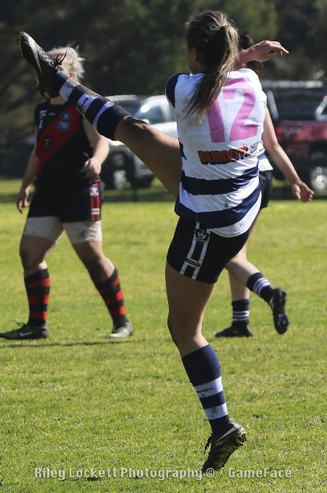
AFLSE Coaching
Wednesday 5 March, 2025.
Russell Davidson
Head of Senior Umpiring
AFL South East
Casey Fields, Cranbourne East VIC 3977 |

Slide 2
GUEST
RC MC March 5 2025
Marking Contests. Rule 18.5.2
What is the spirit of the law in relation to marking contests?
The player whose sole objective is to contest the ball shall be permitted to do so.

Slide 3
GUEST
RC MC March 5 2025
Marking Contests. Rule 18.5.2
Holds or blocks.
Pushes or bumps.
Deliberately interferes with the arms.
Makes contact front on when the objective is not to contest the ball.
Unrealistic attempt to contest or spoil and interferes with an opposition player.

Slide 4
GUEST
RC MC March 5 2025
Marking Contests.
What aspects of positioning make it easier to detect marking contest infringements?
Width always wins
Side on – just short or parallel to the contest.
Forward observation. (Don’t watch the MZ kicker)

Slide 5
GUEST
RC MC March 5 2025
Marking Contests.
Some notes;
The action of the FK (hold etc) does not have to have an influence on the outcome of the contest for it to be a FK.
Incidental contact is permitted provided the sole objective is to contest the footy. Examples?
Deliberately interferes with arms : watch for spoiling hand not near ball, spoiling arm is in a sweeping motion, player out of position.

Slide 6
GUEST
RC MC March 5 2025
Ruck Contests
The ruck whose sole objective is to contest the ball shall be permitted to do so.
Each team must have no more than one ruck contesting any centre bounce, throw up or boundary throw in.

Slide 7
GUEST
RC MC March 5 2025
Ruck Contests
Free kicks are paid for?
- Non designated ruck
- Pushes or bumps
- Blocks
- Makes contact with an opposition ruck prior to the ball leaving the umpires hand.
- Enters the opponents attacking half or steps outside the centre circle prior to the ball being bounced at a centre bounce.
- Hits the ball out on the full from a ball up or boundary throw in.

Slide 8
GUEST
UPDATES
Practice Matches
Mon 10th
Sat/Sun 15th/16th
Sat/Sun 22nd/23rd
Sat 29th
Sorrento visits
Monday 17th, 24th, 31st.
Please ensure that you are registered.

Slide 9
GUEST
CONTACT
Russell Davidson
Head of Senior Umpiring and Field Umpires Coach
Russell.davidson@haileybury.com.au
0409 948 268

