Slide 1
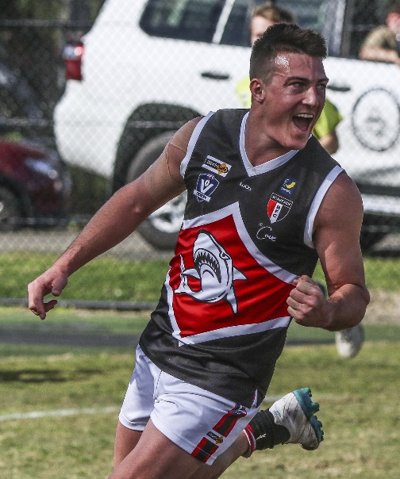
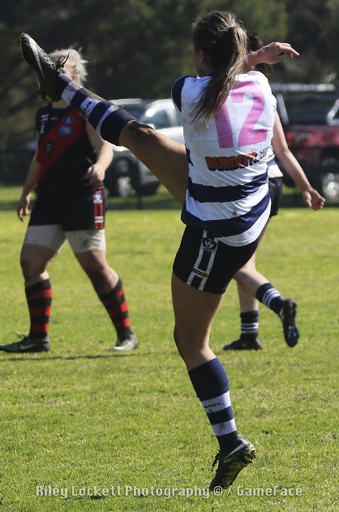
AFLSE Coaching
Wednesday 26 March, 2025
Russell Davidson
Head of Senior Umpiring
AFL South East
Casey Fields, Cranbourne East VIC 3977 |

Slide 2
GUEST
Finals Criteria March 2024
Game Plan
Protect the ball player.
Work for the team.
Do the one percenters.
Take control when needed.
Blend into the game.
Have Fun (before, during and after match).

Slide 3
GUEST
COACHING FINALS CRITERIA
On Field
Decisional accuracy (pays only major and obvious free kicks)
Match management (takes appropriate action, especially at set plays and volatile situations)
Implements the game plan appropriately (Protect the ball player; work for the team; works hard/ gets the one percenters; takes control when needed; blend into the game)
Consistent effort (strong work rate; change of pace; consistently in the best position to adjudicate.)
Appropriate communication (to players, officials and members of our team)

Slide 4
GUEST
COACHING FINALS CRITERIA
Off Field
Has made themselves available for selection on a regular basis.
Regular attendance at pre-season training and coaching.
Regular attendance at and effort during in-season training
Commitment to your fitness (training on off days)
Regular attendance at and participation in coaching sessions
Presentation (off and on the field; punctuality)
Coachability (putting into practice feedback from coaches and following instructions)
Commitment to umpiring in the AFLSE and with SUA.
Positive representation of the AFLSE and SUA brands.
Teamwork (commitment to the umpiring team on the day and the group as a whole)
Appropriate communication when unable to attend training, coaching or to umpire

Slide 5
GUEST
EXTRA
Additional
Senior umpires to double up on 2 occasions throughout the season (if required).
Senior squad umpires to assist with women’s matches throughout the season if required.
Queensland umpire exchange (criteria)

Slide 6
GUEST
COACHING FINALS CRITERIA
Finals Appointments
Senior and Reserve GF’s
To be awarded to the top 12 umpires based on rankings as determined during the season and in the finals.
Umpires 1-3 : Div 1 Senior GF
Umpires 4-6 : Div 2 Senior GF
Umpires 7-9 : Div 1 Reserves GF
Umpires 10-12 : Div 2 Reserves GF

Slide 7
GUEST
COACHING FINALS CRITERIA
Finals Appointments
Under 19 GF’s
To be awarded to the top 6 Development umpires based on rankings as determined during the season.
A Development umpire is defined as one or more of the following;
In his/her 1st/2nd year of senior football.
In his/her 1st / 2nd year of umpiring.
Has the potential to progress to the VFL in the next 1-3 years.
If a Development Umpire is ranked in the top 12, he/she may officiate in a senior or reserve GF.

Slide 8
GUEST
COACHING FINALS CRITERIA
Finals Appointments
Women’s GF’s
To be awarded to umpires who display the following;
A commitment to the AFLSE Women’s competition.
Regular attendence at training.
Regularly take responsibility for their learning.
Accept feedback in a positive manner.
Are unlikely to be considered for senior, reserve or u/19 GF’s.

Slide 9
GUEST
COACHING 2025
Senior Field Squad
Russell Davidson
Wes Mann
Rowan Sawers
Tony Hales
Peter Marshall
Rookie Squad
Peter Bailey
Rob Hansen
* Rookie and Senior squads coach separately on last Wed of each month.

Slide 10
GUEST
FEEDBACK 2025
Sportsguage feedback
Decision making
Positioning (angles, handovers, support positioning)
Skills and Movement (Workrate, holding vision, anticipation)
Match Management (set kick, communication, management of incidents)
Values (attitude, positive engagement with panel, presentation)
Let’s work on this together, On Target, Performing well.

Slide 11
ADMINISTRATION
GUEST
Modules
Availability
Take responsibility
HUDL
Communication

Slide 12
GUEST
CONTACT
Russell Davidson
Head of Senior Umpiring and Field Umpires Coach
Russell.davidson@haileybury.com.au
0409 948 268

