Slide 1
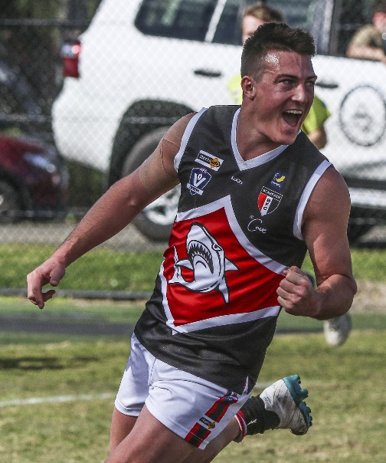
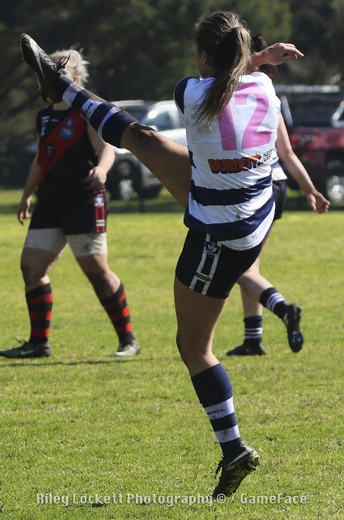
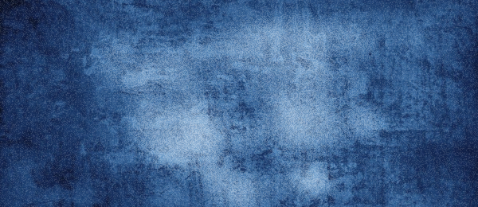
AFLSE Coaching
Wednesday 19 March, 2025.
Russell Davidson
Head of Senior Umpiring
AFL South East
Casey Fields, Cranbourne East VIC 3977 |

Slide 2
GUEST
HT 50m March 19 2025
A field umpire shall award a free kick against a player when that player makes any of the following prohibited contact with an opposition player:
makes high contact to an opposition player (including the top of the shoulders) with any part of their body;
bumps or makes forceful contact to an opposition player from front-on when that player has their head down over the football. A player can bump an opponent’s body from side on but any high contact forward of side on will be deemed as front on.

Slide 3
GUEST
HT 50m March 19 2025
Where the tackle is reasonably applied and the ball carrier is responsible for the high contact via a shrug, drop, arm lift or duck, play on should be called (*Note “duck” is now a cue for prior opportunity).
Continue to protect the ball player. When you are in doubt as to whether the player with the ball was responsible for the high contact, continue to protect the ball player.

Slide 4
GUEST
HT 50m March 19 2025
 | Situation | Result
Front on | Head down over the ball aiming to gain possession
Ducking | Elects to drop head from a high to low position.
Drive | Leads with the head and moves into the tackler who is stationery.
Shrugs | Tackle around the bicep area and the arm forces the tackle high.
Drop | At knees or body – going from a high position to a low position.

Slide 5
GUEST
HT 50m March 19 2025
 | Situation | Result
Front on | Head down over the ball aiming to gain possession | FK for HT (unless the tackler is stationery)
Ducking | Elects to drop head from a high to low position. | Must successfully dispose of the ball as ducking is considered a prior opportunity.
Drive | Leads with the head and moves into the tackler who is stationery. | Must successfully dispose of the ball as a drive is considered an action for a prior.
Shrugs | Tackle around the bicep area and the arm forces the tackle high. | Play on if you deem that the player with the ball is responsible for the HT.
Drop | At knees or body – going from a high position to a low position. | Play on if you deem that the player with the ball is responsible for the HT.

Slide 6
GUEST
HT 50m March 19 2025
Where a field Umpire has awarded a Mark or Free Kick to a Player, or a Player is preparing to bring or bringing the football back into play after a Behind is scored, a Fifty Metre Penalty in favour of that Player will be awarded if the field Umpire is of the opinion that any Player or Official from the opposing Team has???

Slide 7
GUEST
HT 50m March 19 2025
has moved off The Mark;
when in the immediate contest, unreasonably holds a Player after that Player has Marked the football or been awarded a Free Kick;
when not in the immediate contest, holds a Player after that Player has Marked the football or been awarded a Free Kick;
enters or does not make every endeavour to immediately vacate the Protected Area, except when the Player is accompanying or following within two metres of their opponent;
has not returned the football directly and on the full to the Player awarded the Mark or Free Kick;
engages in any conduct which delays or impedes the play; or
engages in any other conduct for which a Free Kick would ordinarily be awarded.

Slide 8
GUEST
HT 50m March 19 2025
PREVENTING A PLAYER TAKING PART IN THE NEXT ACT OF PLAY.
If a Player intentionally makes Prohibited Contact against an opposition Player who has disposed of the football for the purpose of preventing that Player from taking part in the next act of play, the field Umpire shall award a Free Kick and a Fifty Metre Penalty to that Player

Slide 9
GUEST
UPDATES
Practice Matches
Sat/Sun 22nd/23rd
Sat 29th
Sorrento visits
Monday, 24th, 31st.
Hastings Parkrun
- Sat 29th
Please ensure that you are registered.
Modules completed?

Slide 10
GUEST
CONTACT
Russell Davidson
Head of Senior Umpiring and Field Umpires Coach
Russell.davidson@haileybury.com.au
0409 948 268

