Slide 1
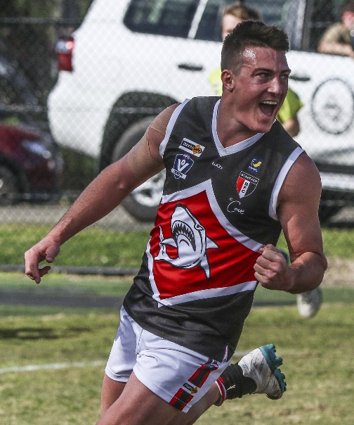
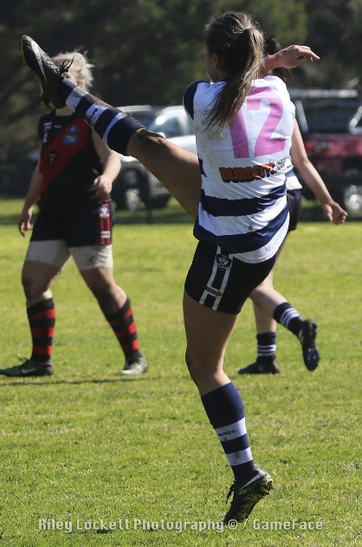
AFLSE Coaching
Wednesday 12 March, 2025.
Russell Davidson
Head of Senior Umpiring
AFL South East
Casey Fields, Cranbourne East VIC 3977 |

Slide 2
GUEST
II March 12 2025
Summary
Holding the Ball
Marking contests
Ruck Contests
Use the language.

Slide 3
GUEST
II March 12 2025
Insufficient Intent
Spirit : Players shall be encouraged to keep the ball in play.
Law : A FK will be awarded against a player who Kicks, Handballs or forces the football over the Boundary Line and does not demonstrate sufficient intent to keep the football in play.

Slide 4
GUEST
II March 12 2025
Insufficient Intent
When adjudicating insufficient intent, what cues assist us to determine whether or not to pay a FK?

Slide 5
GUEST
II March 12 2025
Insufficient Intent
When adjudicating insufficient intent, what cues assist us to determine whether or not to pay a FK?
Force
Direction
Players

Slide 6
GUEST
II March 12 2025
Force : more likely to pay if there is an element of force.
Direction : more likely to pay if forced directly over the boundary line.
Players : more likely to pay if the ball is forced over the line with no teammates in the vicinity.

Slide 7
GUEST
UPDATES
Practice Matches
Sat/Sun 15th/16th
Sat/Sun 22nd/23rd
Sat 29th
Sorrento visits
Monday 17th, 24th, 31st.
Hastings Parkrun
- Sat 29th
Please ensure that you are registered.

Slide 8
GUEST
CONTACT
Russell Davidson
Head of Senior Umpiring and Field Umpires Coach
Russell.davidson@haileybury.com.au
0409 948 268

