Slide 1
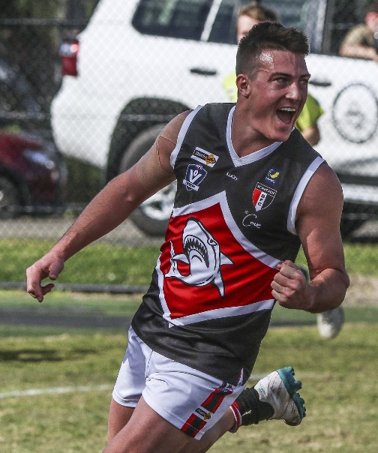
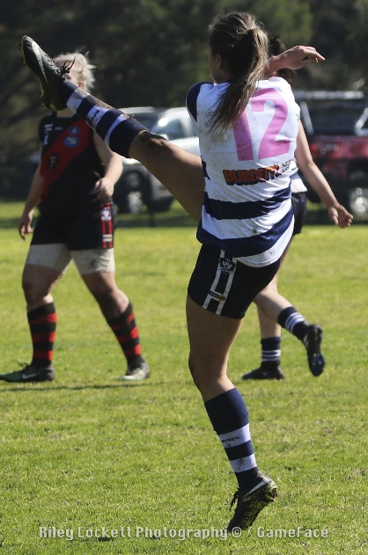
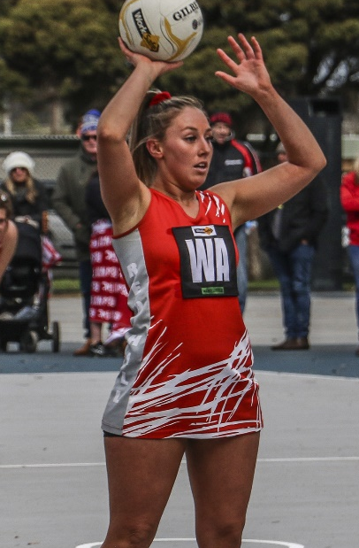



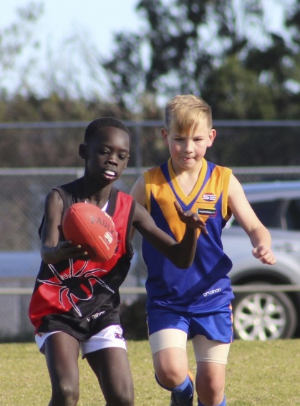
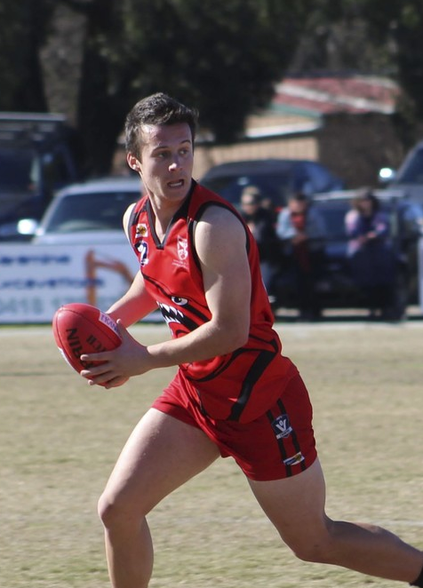
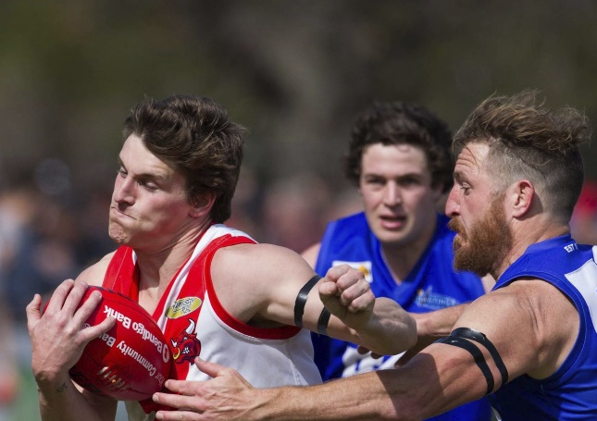
AFL South East – Senior Umpires Meeting
Wednesday March 22
Kananook Reserve, Seaford
AFL South East
Casey Fields, Cranbourne East VIC 3977 |

Slide 2

GUEST
Introduction & Acknowledgement of Country
Haydn O’Connor
Senior Football (MPFNL) & Region Umpire Manager – AFL South East

Slide 3
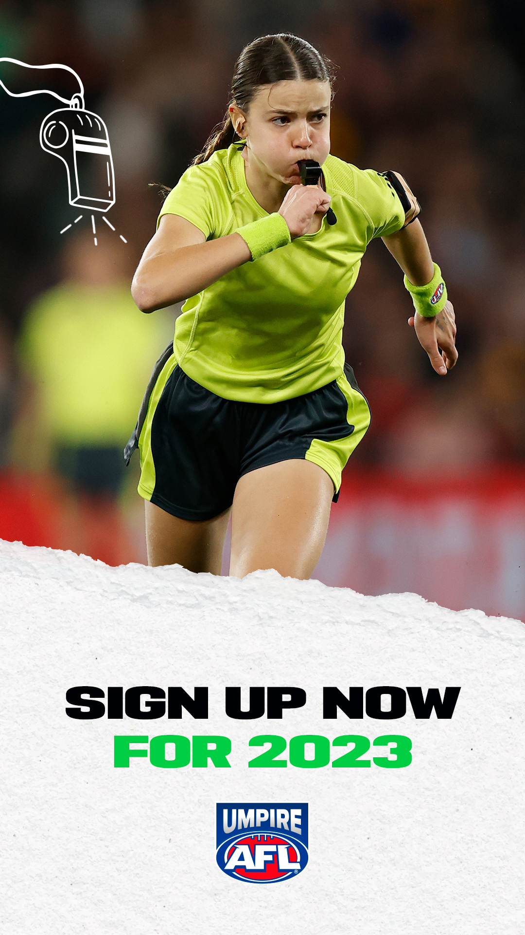
GUEST
Introduction
  AFL South East Football & Umpiring Department Update
    Zac Davies departure
    New Football & Umpire Coordinator to be announced shortly.
  REGISTRATION SNAPSHOT (AFL South East)
  2022 Registered – 409 Total
  Currently Registered – 385
  Returning Umpires – 223
  New Umpires – 162
  Year to Date – 44% increase from this time in 2022! (169 registered this time last year)
  Registration.officialshq.com/
    Select AFL South East/SUA as your Umpiring Club
  Practice Matches
    Plenty of Opportunities this weekend, see your discipline coach if you are available.
    Practice Match Payments processed next week.

Slide 4

GUEST
AFLSE/SUA – Senior Umpires
  Mornington Peninsula Football Netball League
  April 1 through to September 16
    Seniors (Sat - 2pm*) – 11 games per weekend.
      Field, Boundary & Goal.
    Reserves (Sat - 12pm*) – 11 games per weekend.
      Field, Boundary & Goal.
    Under 19s (Sat - 10am*) - 7 games per weekend#
      Field, Boundary & Goal.
      * unless specified otherwise (i.e Saturday night matches/Easter weekend/Kings Birthday weekend & Finals).
Division 1 - Bonbeach, Dromana, Frankston Bombers, Frankston YCW#, Langwarrin, Mt Eliza, Pines, Red Hill, Rosebud, Sorrento#.
Division 2 - Chelsea#, Crib Point#, Devon Meadows, Edithvale-Aspendale, Hastings, Karingal, Mornington, Pearcedale, Rye, Seaford, Somerville, Tyabb.
    No 6,6,6.
    No Deliberate Rushed Behinds

Slide 5

GUEST
AFLSE/SUA – Senior Umpires
  South Eastern Women’s
  April 22 through to September 2
    Premier Division – 3 games per weekend.
      Field. (Finals TBC)
    Division 2 – 2 games per weekend.
      Field. (Finals TBC)
    Division 3 – 5 games per weekend.
      Field. (Finals TBC)
  Premier – Frankston (VFL), Karingal, Mornington, Seaford, Tyabb, Warragul Industrials*
  Division 2 – Bass Coast*, Edithvale-Aspendale, Mornington, Pearcedale, Seaford
  Division 3 – Bonbeach, Cerberus*, Fountain Gate, Hastings, Karingal, Mornington, Mt Martha, Pines, Red Hill, Warragul Industrials*
  10 MPFNL Clubs compete in the SEWF with an increase in Friday Night & 4.40pm matches following MPFNL matches.
  Frankston (VFL) investigating double headers which will use as opportunity for Umpires to be seen by VFL Talent.
  Field Umpires to throw up 10 metres from Boundary Line.
  Stand Rule implemented in 2023

Slide 6
GUEST
Pay Rates for 2023
Umpire – Home & Away | League | # Umpires | 2023 Fee
Senior Field | MPFNL | 2 | 160
Senior Field | MPFNL | 3 | 142
Senior Boundary | MPFNL | 2 | 95
Senior Boundary | MPFNL | 3 | 77
Senior Goal | MPFNL | 2 | 85
Reserves Field | MPFNL | 2 | 105
Reserves Field | MPFNL | 3 | 80
Reserves Boundary | MPFNL | 2 | 68
Reserves Boundary | MPFNL | 3 | 53
Reserves Goal | MPFNL | 2 | 65
U19 Field | MPFNL | 2 | 95
U19 Field | MPFNL | 3 | 70
U19 Boundary | MPFNL | 2 | 65
U19 Boundary | MPFNL | 3 | 50
U19 Goal | MPFNL | 2 | 65
Premier Field | SEWF | 2 | 105
Division 2 Field | SEWF | 2 | 95
Division 3 Field | SEWF | 2 | 90
KEY POINTS
Pays are facilitated by the AFL (not AFLSE) fortnightly. You will receive a pay advice during the day, money should hit your account Tuesday night/Wednesday.
As paid Umpires fall under the AFL Victoria/AFL South East Code of Conduct (AFL Vic Country Handbook 9.2) & Social Media Policies.
Bank details must be updated on OfficialsHQ
Women’s Football now part of our Senior AFLSE/SUA Ump Department
MPFNL/SEWF clubs are charged for Umpires for Home & Away Season per week per umpire
AFL South East pay finals and are committed to fix rate Finals Loading for 2023.

Slide 7
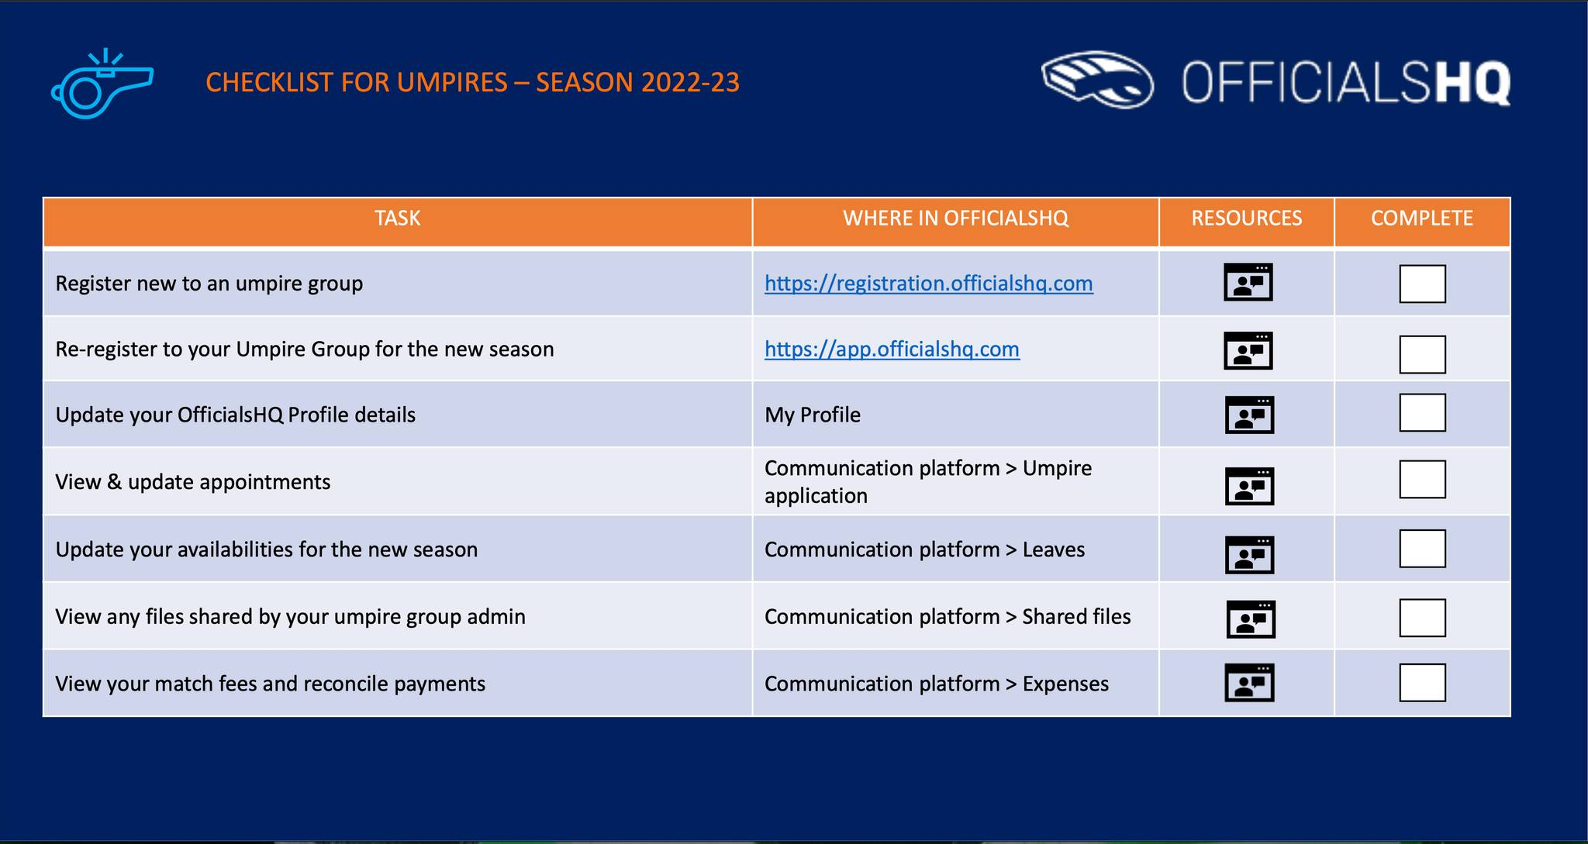
GUEST
Pre-Season Checklist – Officials HQ

Slide 8
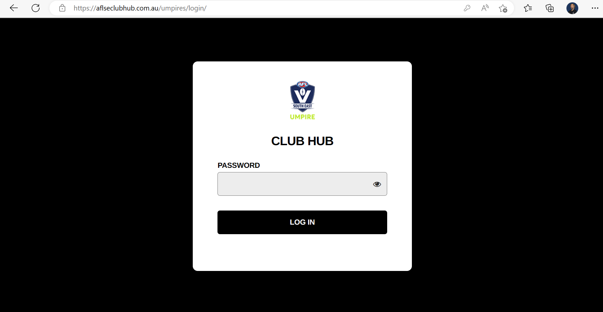
GUEST
Pre-Season Checklist – Other Items
    AFL SOUTH EAST CLUB HUB
      aflseclubhub.com.au/umpires
      Password: Umpires
    UNIFORM
      Project Clothing – AFL South East
      Off-Field - SUA
    WORKING WITH CHILDREN CHECK
      This is Mandatory if over 18
      Volunteer
      AFL South East
      OfficialsHQ - Accreditations
    SUA MEMBERSHIP
      www.sua.org.au/
      We support the SUA supporting you and encourage you to buy a membership

Slide 9
GUEST
Monday
    Juniors Training (all welcome)
      Kananook Reserve
      Casey Fields Oval 2
      Heatherbrae Reserve
    Premier Data – Matches Uploaded
      Access to be given to all Senior Umpires after Round 1.
    Coaches required to submit appointments to AFL South East (your availability MUST be updated on OfficialsHQ)
Tuesday
    Pay (fortnightly)
    If you have any Pay Enquiries head to Club Hub – Pay Enquiries
    Check Club Hub for any News from HQ.

Slide 10
GUEST
Wednesday
    Main Training (Check Training Information)
      Check Club Hub for Training Information
      If you are unavailable contact your discipline coach
    If you are injured or need attention
      There are rehab programs with Jaye Edmunds
    Appointments released via OfficialsHQ email
      Confirm or deny your appointment ASAP! (contact your discipline coach prior to denying an appointment)
Thursday/Friday
    Sudden Unavailability
      If you are suddenly unavailable contact your discipline coach
      Please consider the impact on your teammates if you do withdraw on your appointment
    Coaching Session posted on Club Hub.
    Appointments posted on Club Hub.

Slide 11
Saturday – Game Day
GUEST
    On Field Uniform
    Umpires are required to officiate in their games in the approved uniform.
    The approved uniforms are:
      Field/Boundary Umpires
      Officially Uniform with current sponsors displayed (purchased from Project Clothing)
      Running Shoes: predominantly white in colour
      Football Boots (for muddy/wet grounds) preferably white
      Whistle
      Goal Umpires
      Black Boots
      Grey Trousers
      Officially endorsed Uniform with current sponsors displayed (purchased from Project Clothing)
      Flags
    Off Field Uniform
    AFL South East strongly encourage SUA Off-Field Apparel with clean neat apparel. Dress appropriately for your match.

Slide 12
Saturday – Arrival
GUEST
    Arrive at the Ground with plenty of time.
      Specific times for each discipline and grade will be determined by the discipline coach.
      IF YOU ARE LATE, contact other umpires via their contact details on OfficialsHQ
      IF YOU CANNOT CONTACT any other umpire, contact your discipline coach.
      MPFNL – Your appointment (screenshot from OfficialsHQ or Print it out) grants you access to your match, Gate Staff (Team Staffing) have been told that Umpires under 18 get 1x Free Guardian with them.
    Pre-Match
      Field Umpires
      Wherever possible, introduce yourself to the two coaches before you enter the change rooms.
      Get changed for your game, allowing yourself enough time to be at the clubs at the time you agreed.
      When you enter the rooms, introduce yourself to the club captain. It is advisable to always go to the visiting club first.
      The visiting Captain will choose which of the two balls will be the match ball to use. Refer to the MPFNL By-Laws procedures if the conditions are wet or muddy.
      Your visit to the rooms should be unobtrusive and establish a friendly contact at this stage.
      Never attempt to advise how you are going to umpire or interpret a particular rule.
      Boundary/Goal Umpires
      Get changed at least 30 mins prior to the start time of the game. Try to find a good flat area to warm up in. You may also choose to be ready and have a warm-up run at three quarter time of the game before yours

Slide 13
Saturday – No Report
GUEST
Match Report
If you are the first named Field Umpire via the OfficialsHQ Appointment Notification you are required to submit a Match Report for every match you Umpire.
If for whatever reason this is unavailable, each MPFNL & SEWF Umpire Room will have a QR Code, scan this and it will take you to the AFLSE Umpire Club Hub – Login and select Match Day Paperwork.
Step 1. To view and complete any match reports that have been added to an appointment click on the Match Reports link
Step 2. On the Match reports page on the left hand side will be a list of match reports linked to the appointment click on each match report.
Step 3. click on the Fill out report link to open the match report.
Step 4. Complete the match report and click on the Submit button in the top right corner.
Step 5. A Submit pop-up will appear, click on Yes.
Step 6. A message will show when the match report has been submitted successfully. On the Match reports page if a match report has been completed and submitted the link will no longer be available.
Awards
Best & Fairest Awards are given in MPFNL/SEWF.
These are highly prestigious and the responsibility of Umpires to complete these with care and thought to the 3 Best & Fairest players in the match.
Step 1. To view and complete any awards that have been added to an appointment click on the Awards link.
Step 2. Complete the award information required and click on the Send button in the bottom right corner.

Slide 14
Saturday –Reportable Incident
GUEST
• Stop Play (if Field Umpire reporting)
  If Boundary or Goal Umpire notify Field Umpire at next available break.
• Clear player/s away from incident
• Only player/s involved are to remain.
• Seek assistance from other umpires to assist if needed.
• Advise player/s if they have been reported and what for.
  If report is laid by the Boundary or Goal Umpire, the reporting umpire must communicate this at the next available break.
• Inform reported player/s what card (YELLOW/RED) they are being sent off on.
  Field Umpires to use Cards based off information given by the Boundary or Goal Umpire if they are the ones reporting at the next available break.
• Raise YELLOW/RED card in the air so the TIME KEEPERS & TEAM MANAGERS are aware of what card the player/s are being sent off on and how long they are expected to spend on the sidelines.
• Player/s are to leave the playing field.
• A Yellow Card requires the player to be ordered off for 15 minutes of actual playing time and cannot be replaced during that time.
• A Red Card requires the player to be ordered off for the remainder of the match and can be replaced after 15 minutes of actual playing time.
• The game is not to resume until the umpire making the report has collected all information they require.
• In SENIORS (MPFNL & SEWF) it is the expectation that whenever a card is issued; a report is to be made.
• In the U19s & Reserves competition a yellow card can be used as a ‘cooling off’ mechanism.

Slide 15
Saturday – Reportable Incident Paperwork/Follow Up
GUEST
Each MPFNL/SEWF Umpires Room will have a QR Code.
  If for any reason there isn’t, head to aflseclubhub.com.au/umpires and click Match Day Report
  Click Match Day Report Process (Seniors)
https://form.jotform.com/210797366556872
Ensure senior umpires assist junior umpires complete Report Form
3 types of Reportable Offence (National Community Handbook)
  Direct to Tribunal Offences
  Low-Level Offences (AFLSE – Other Offence)
  Classifiable Offences

Slide 16
Saturday – Direct Tribunal Offences (Red Card)
GUEST
Attempting to Strike an Umpire
Behaving in an Abusive, Insulting, Threatening or Obscene Manner Towards or in Relation to an Umpire
Eye Gouging
Intentional Contact with an Umpire
Spitting on Another Person
Spitting on or at an Umpire
Stomping
Striking an Umpire
Serious Misconduct

Slide 17
Saturday – Other Offences (Yellow Card & Set Penalties)
GUEST
1st & 2nd Offence AFLSE to review Monday |  | 3rd & Subsequent Offence AFLSE to review Monday
Base Sanction | Early Guilty Plea (Set Penalty) | Base Sanction | Early Guilty Plea (Set Penalty)
1 Match | Reprimand & Fine | 2 Matches | 1 Match
Attempt to Strike / Kick / Trip
Careless Contact with an Umpire
Disputing Decision
Instigator of a Melee
Interfering with a Player Kicking for Goal
Unreasonable or Unnecessary Contact with an Injured Player
Unreasonable or Unnecessary Contact with an Umpire
Engaging in a Melee
Not Leaving the Playing Surface
Obscene Gesture
Pinching
Prohibited Boots, Jewellery or Equipment
Scratching
Shaking, Climbing or Interfering with Goal or Behind Post
Spitting at Another Player
Staging
Time Wasting
Using Abusive, Insulting or Obscene Language Towards or in relation to an Umpire
Using Abusive, Insulting or Obscene Language
Wrestling

Slide 18
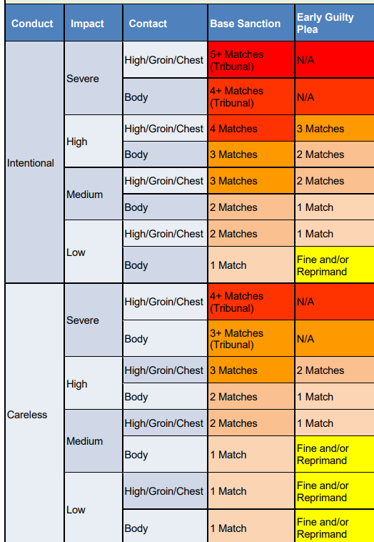
Saturday – Classifiable Offences (Yellow or Red Card)
GUEST
Classifiable Offences
CONDUCT
Intentional or Careless
IMPACT
Severe, High, Medium, Low.
CONTACT
High/Groin/Chest or Body
EARLY GUILTY PLEA
Replaces the Set Penalty

Slide 19
Saturday – Classifiable Offences (Yellow or Red Card)
GUEST
Charging
Unreasonable or Unnecessary Contact to the Eye Region
Forceful Front-On Contact
Headbutt or Contact Using Head
Kicking
Kneeing
Rough Conduct
Striking
Tripping
Unreasonable or Unnecessary Contact to the Face

Slide 20
Saturday – Impact of Classifiable Offences
GUEST
Low – Player Minimal or No impact on the match – Player continued to play
Medium – Clearly some impact on the player, and/or Player left the field for a period.
High – Major impact on the player, and/or the Player was unable to participate for the remainder of the match.
Severe – Major impact and serious injury.
Ability to upgrade if you believe there was potential to cause serious injury

Slide 21
Saturday – Following Match Day Report
GUEST
If Not Immediate Tribunal
• Run through the report sheet with Team Mangers (ONLY TEAM MANAGERS)
• Team Managers will decide whether to accept an Early Guilty Plea (please note clubs have until 12pm Monday to accept or contest)
• Submit form and contact Haydn O’Connor (0473 924 968) via text with a short message outlining report and outcome if known.
If Immediate Tribunal
    Run through the report sheet with Team Mangers (ONLY TEAM MANAGERS)
    Submit form and contact Haydn O’Connor (0473 924 968) via text with a short message entitled URGENT.
If there is a matter which you have NOT seen but notified by Team Managers
    Tell Team Managers to contact Haydn O’Connor via email as MRO/Incident Report is available to Clubs.
After Game Day
    AFL South East will be notified of report via Jotform and via text to Haydn O’Connor.
    Notification to attend Tribunal will occur on Monday.
    Attend Tribunal Hearing via zoom (or in person if you wish)
    An umpire advocate will be allocated to assist you on the night during the hearing either online or in person.

Slide 22
Competition Websites
GUEST
www.aflsoutheast.com.au/mpfnl
www.aflsoutheast.com.au/sewf
www.aflsoutheast.com.au/umpires
www.sua.org.au/
AFL SOUTH EAST CLUB HUB - RESOURCES
  aflseclubhub.com.au/umpires
  Password - Umpires

Slide 23
Key Contacts – Seniors (MPFNL/SEWF)
GUEST
Role | Name | Email | Contact | Available
Senior Football (MPFNL) & Region Umpire Manager | Haydn O’Connor | haydn.oconnor@aflse.com.au | 0473 924 968 | Mon to Fri 9am to 5pm Saturday via Text
Senior Football (MPFNL) & Umpire Coordinator | TBC | Umpire.info@aflse.com.au |  | Mon to Fri 9am to 5pm
Head of Seniors & Field Umpire Coach | Russell Davidson | Umpire.snrfield@aflse.com.au | 0409 948 268 | Training Nights & Senior Match Day
Senior Boundary Head Coach | Adam Holland | Umpire.snrboundary@aflse.com.au | 0412 322 452 | Training Nights & Senior Match Day
Senior Goal Head Coach | Dean Jones | Umpire.snrgoal@aflse.com.au | 0466 863 744 | Training Nights & Senior Match Day
SUA Chairperson | James Richardson | Chairman.sua@gmail.com | 0430 566 865 | Training Nights

